Slide 1
Fabrication processes
Fabrication process starts with the joining of base plate with movable plate.
The joining will be completed by the help of bolts.
This will be followed by the joining of main pipe with the movable plate.
The spring assembly and striking rod will be inserted in the main pipe.
Then the link will be connected with main pipe and movable assembly to control the projection process.
Then an electronic switch will be inserted to control link used for projection.

Slide 2
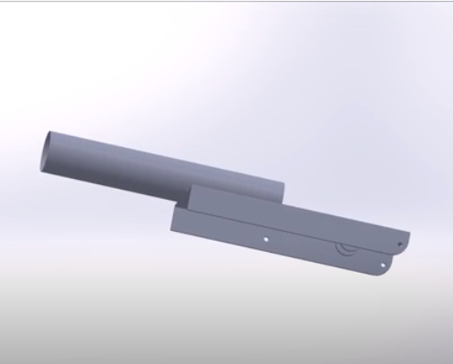
Steps of fabrication:
Step 1:
Joining of main pipe and movable plate:

Slide 3
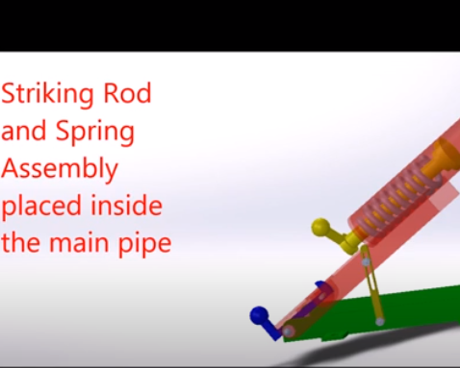
Step 2:
Striking rod and spring assembly placed inside the main pipe:

Slide 4
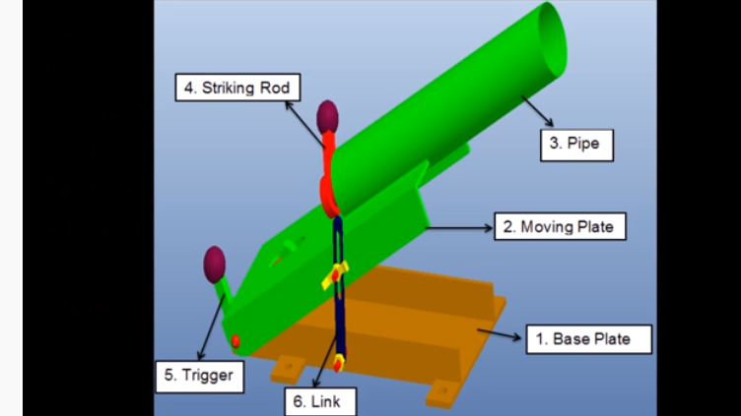
Step 3:
Link and electronic switch inserted in the device to complete
fabrication.

